Slide 1
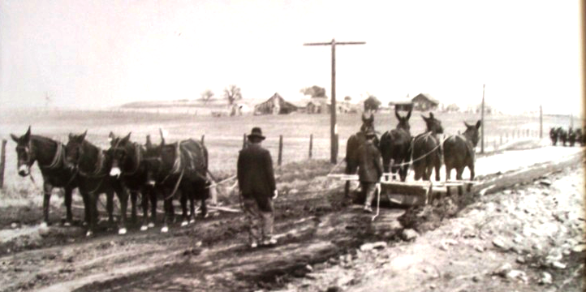
Township Meeting
What is your road I.Q.
Norm Bowers, Local Road Engineer
Kansas Association of Counties

Slide 2
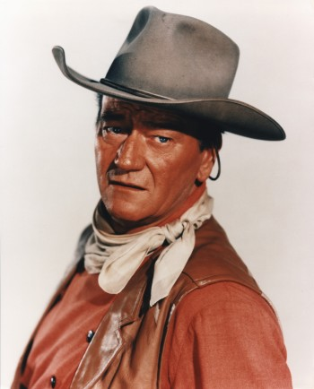
Life is Hard
“Life is hard, it is harder if you are stupid.”
John Wayne
“Road work is hard, it is harder if you are stupid.”
Norm Bowers

Slide 3
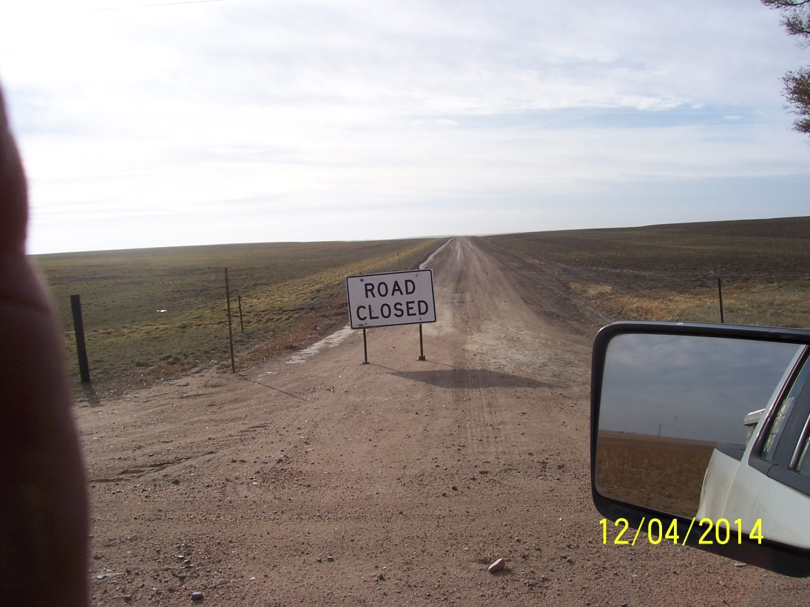
Know Your Job
Ignorance of the law is no excuse.
We have always done it that way doesn’t make it right.
Stay informed and keep up with the times.

Slide 4
Today will be a series of questions that road officials should know.
Think of the answer and see if you were right.

Slide 5
Question: Liability Excuses
Question: If a person is injured due to a defect in the road can liability be avoided based on effort to keep taxes low.
Answer: NO! We have certain duties under the law and being cheap is not an excuse.

Slide 6
Our Legal Duty to Motorists- Roads
Mandatory duty to construct & maintain public roads reasonably safe for use by motorists.
Counties & Townships: (KSA 68-115) “and the county engineer or township trustee respectively shall keep the same in repair, and remove or cause to be removed all obstructions that may be found therein.”
Local authorities in their respective jurisdictions are required to “place and maintain such traffic control devices upon highways under their jurisdiction as they may deem necessary to indicate and to carry out the provisions of this act or local traffic ordinances or to regulate, warn or guide traffic.” K.S.A. 8–2005(a)
Note: MUTCD requires that all traffic signs “should be kept in proper position, clean and legible at all times.

Slide 7
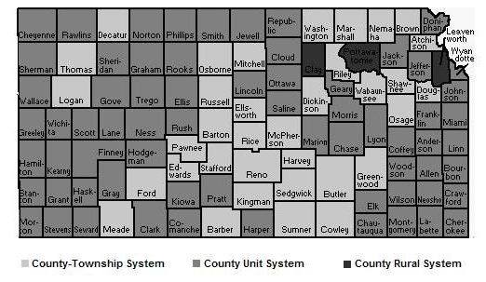
Road Systems: Only one county has converted from township road system in the last 30 years. People in town do not want to pay taxes for rural roads.

Slide 8
Budgets
Townships are not going out of the road business, don’t be short sighted.
Budget enough to:
Maintain roads reasonably safe for use by motorists
Keep signs in good condition
Include some training

Slide 9
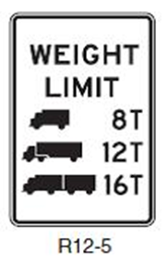
Load Limit Sign Example
8 tons for single unit vehicle (straight truck)
12 tons for 2 unit vehicle (tractor – trailer)
16 tons 3 unit vehicle
(double trailer)

Slide 10
Load Limit Sign
What is the weight limit for a tractor and grain cart on this bridge?
Answer: 12 tons
Weight limit for combine?
Answer: 8 tons

Slide 11
Renting township equipment
Question: Can you rent the township equipment to a board member to repair some erosion in his field?
Answer: You can’t rent township equipment or do any private work except clearing driveways for a charge.
See KSA 68-141 a & b.

Slide 12
Board Meetings
I inadvertently met another board member on the road, and we discussed a request for a driveway culvert. We decided to install the culvert.
Is this legal?
No! You violated the Kansas Open Meetings Act

Slide 13
Kansas Open Meetings Act
Board meetings have to be open to the public.
Special meetings –
  You have to notify anyone that has requested notification in the last year.
  You have to notify all board members
  You have to have minutes

Slide 14
Kansas Open Meetings Act
Board decisions have to be made at a public meeting.
You didn’t give the other board member a chance to participate.
Did you call the meeting to order?
Did you take a vote?
Did you do minutes?
In order to do business between board meetings you can delegate certain decisions to an individual that would report on activities at the next board meeting.

Slide 15
Boundary Road Responsibility
Question: On a township boundary road your township maintains that mile. Which township has the responsibility for the stop sign for traffic coming from the other township.
Answer: I don’t know, it depends on the agreement.
It is important that you know your responsibilities on boundary roads.

Slide 16
Agreements between road agencies
KSA 68-169
Any county, city or political subdivision of this state shall have the authority to enter into written agreements with each other or with the secretary of transportation with respect to the planning, designing, financing, constructing, reconstructing, maintaining, acquiring of right-of-way or establishing the controlled access facilities of any existing or proposed highway, road, street or connecting link, including bridges, traffic control devices and other such improvements located thereon. Expenditures made pursuant to such agreements shall be considered proper expenditures of public funds, including state funds, notwithstanding the location of such improvement or facility outside the boundary or jurisdiction of such county, city or political subdivision.

Slide 17
Weight Limit Sign
Question: I am a township board member and noticed a weight limit sign down near a county culvert. I didn’t call the county as it is not a township sign and not my problem.
Right or Wrong Decision?
Wrong! As a township official you have a duty to people driving your roads. You don’t have a duty to repair the sign but you do have a duty to notify the county.

Slide 18
Logic Check
Public Safety: Anytime you make a decision contrary to public safety you are making the wrong decision.

Slide 19
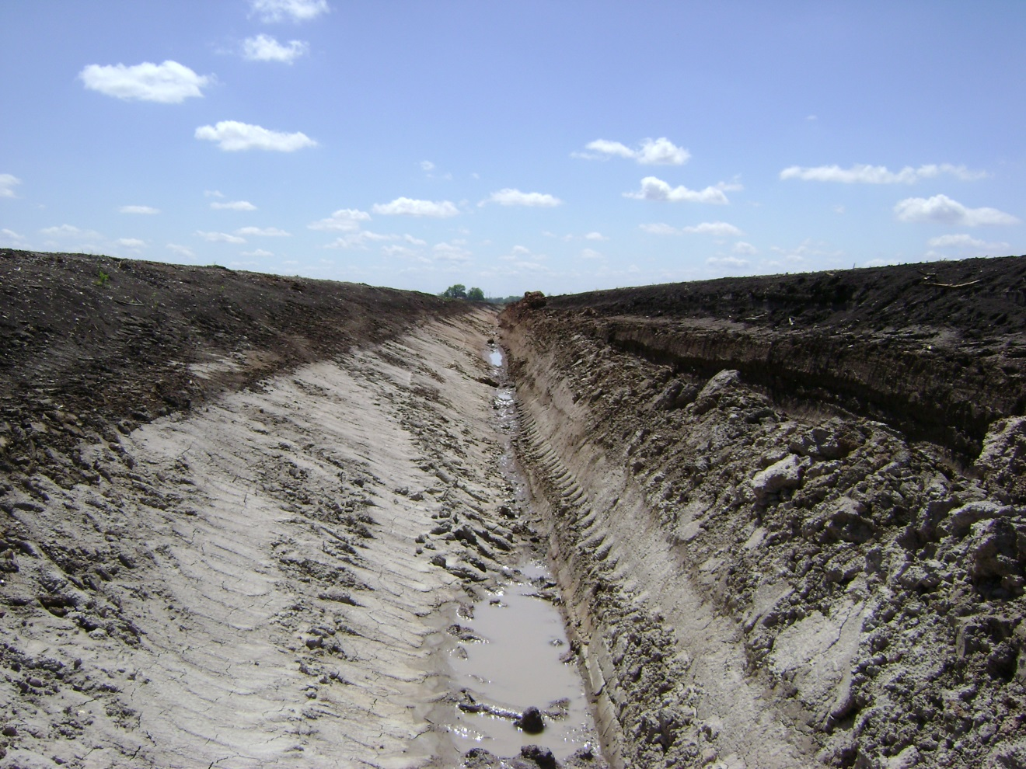
Drainage
  Question: Land owner wants a deep ditch cut along his property to help drain his field. Is this a good idea?
  Answer: Probably not.

Slide 20
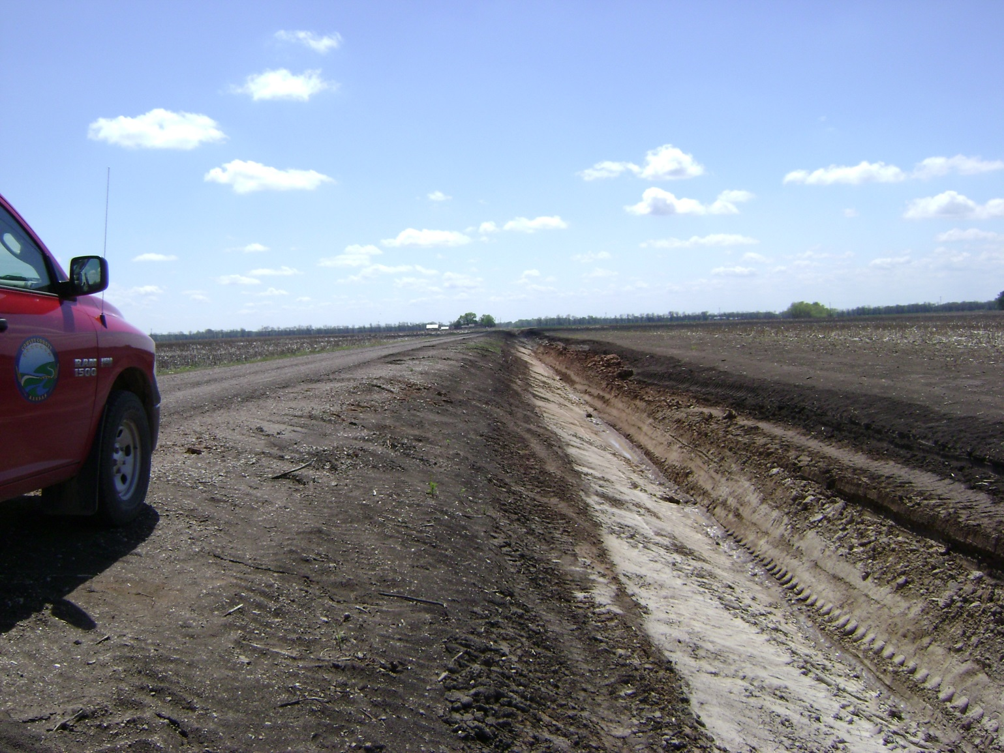
Does this make it safer?

Slide 21
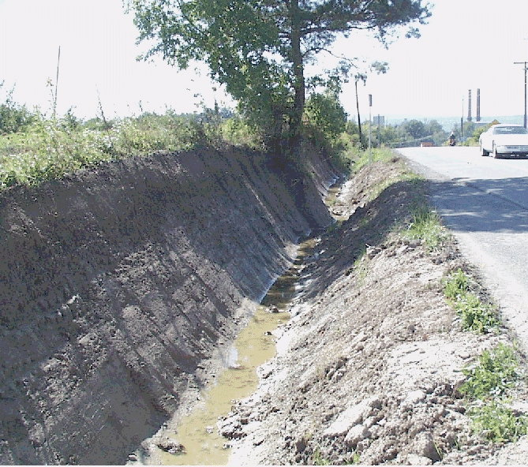
Public Safety –Make it Better
Make it Better: On maintenance work where there are no plans or design, the project should be thought out so the situation is safer for the travelling public.

Slide 22
Make it Better
Make it better: Never create a problem!
Roadway at culvert same or wider than approach
Foreslopes are not steeper than approach
Road floods less
Install proper signing

Slide 23
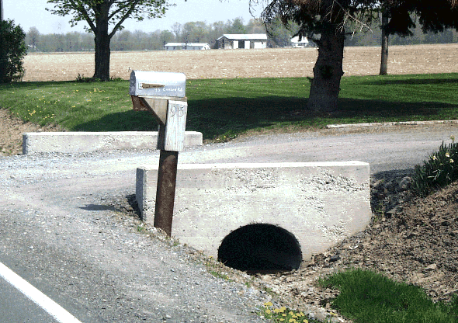
Making it safer
Driveway culvert needs to be replaced, landowner had installed headwalls. Should headwalls be replaced?
No. Headwalls are a traffic hazard. Never spend public money to replace traffic hazards. Just slope the ends.

Slide 24
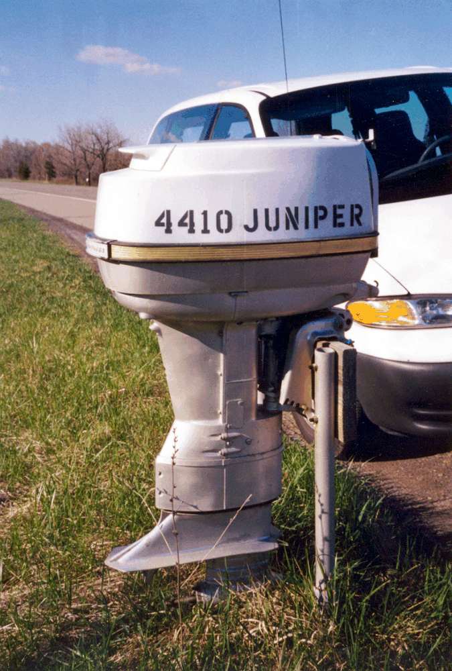
Mailboxes
Snow plow damaged ornamental mailbox and land owner wants it repaired.
Should you repair the mailbox.?
NO. Mailbox is obvious traffic hazard and should not be repaired with public money.
Offer to replace with crashworthy mailbox.
Notes:
Mailbox embedded in outboard's engine cover. On a state route, 55 mph speed limit. Clear zone is otherwise pretty good.

Slide 25
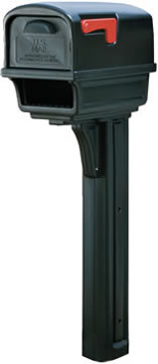
Crashworthy Mailbox
Mailboxes are necessary obstruction in the right-of-way.
Do not allow new ones that are not crashworthy.
Be careful about repairing or replacing boxes that are obviously not crashworthy.
Crashworthy Mailbox-one piece plastic over 4 x4 wood post.

Slide 26
Unsafe Obstructions
I always advise road departments to never replace or repair unsafe obstructions.
It is bad enough we allow the obstructions to remain, it is worse to spend public funds on maintaining or repairing the obstruction.

Slide 27
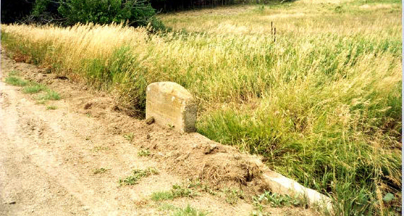
Handrail Removal
Question: Can I remove this old handrail?
Yes: Remove old broken rails, not serving any purpose, if less than 8 ft. to channel. Needs object marker.

Slide 28
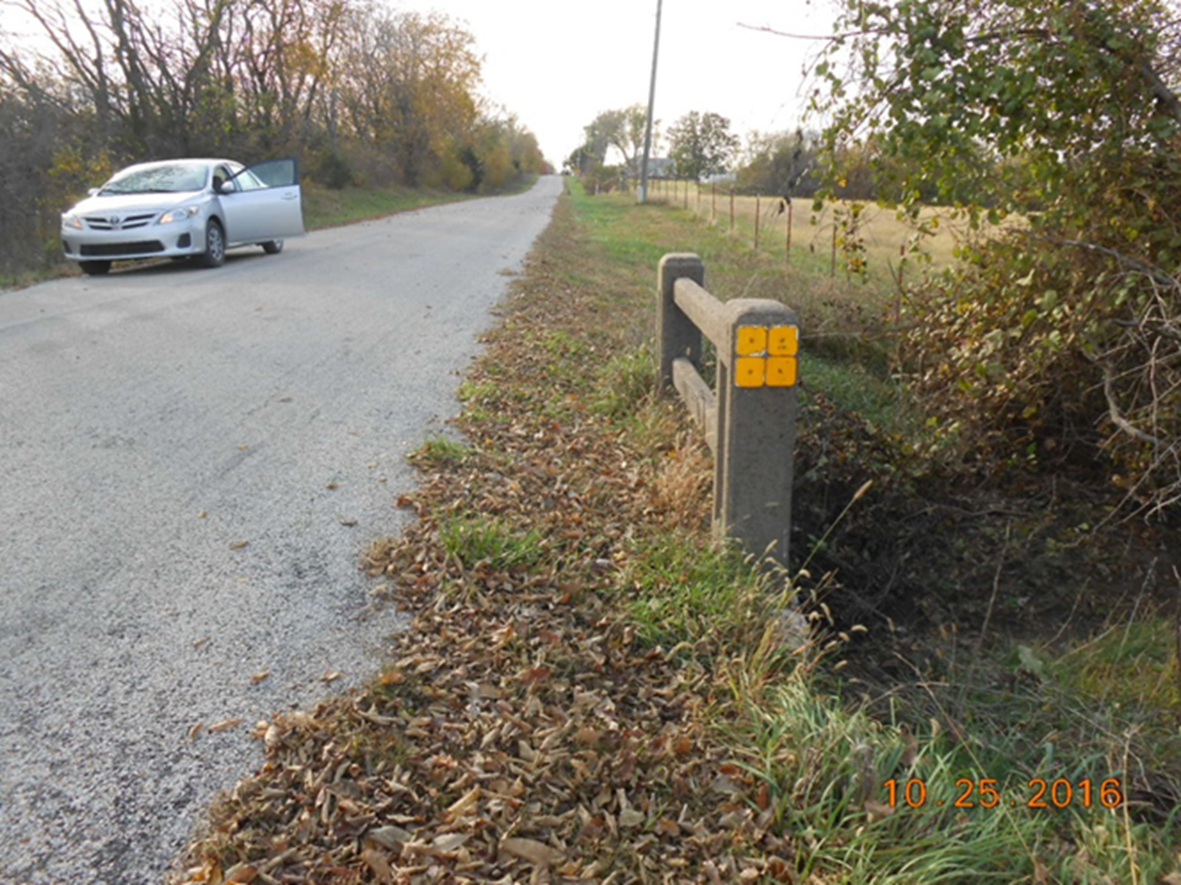
Handrail Removal
Question: Can I remove this concrete handrail?
Answer: Yes, if less than 8 ft. to channel. Still need an object marker.

Slide 29
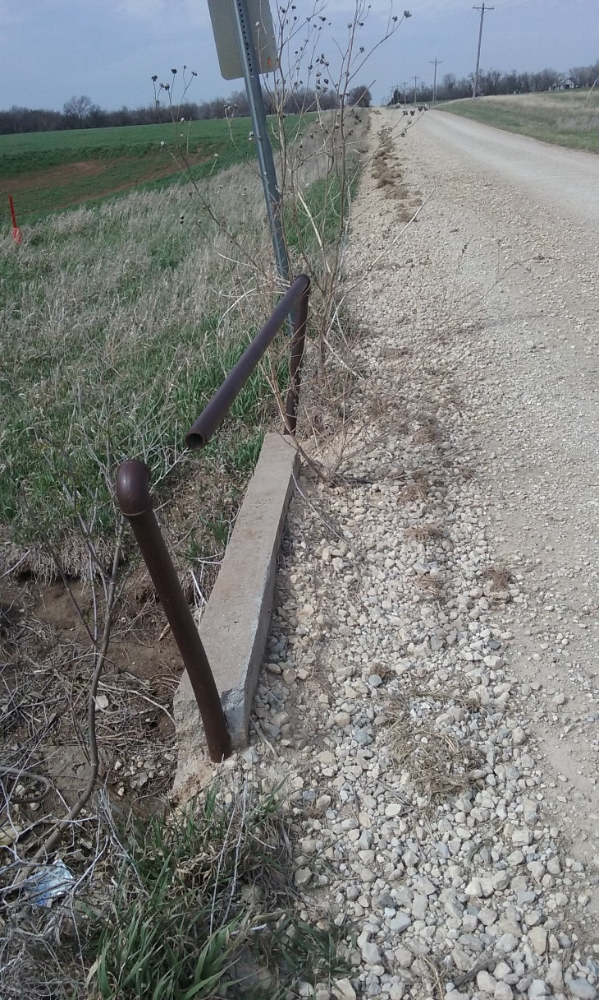
Steel handrails
Question: Can I remove old steel handrails?
Answer: Yes Old steel rails do not serve any purpose and are actually a spearing hazard.

Slide 30
Road Right-of-way
The township or county has control over the road right-of-way and can do anything we want. True or False
False: We have a road easement. It is a powerful easement and we can do about anything we want if it is reasonable and for the right reason. The right reason is public safety and road purposes.

Slide 31
Road Easements
In Kansas the government does not own the road. The adjacent land owner owns the road, the local government has an easement.
Road easement gives us a lot of rights, but remember we are not the land owner.

Slide 32
What can we do on the right-of-way
Just about anything as long as it necessary for road maintenance or for public safety.
Cut trees and brush
Clean ditches and haul off dirt
Remove traffic hazards and obstructions. In fact we are required by law to remove obstructions

Slide 33
What we cannot do
Do things not related to road easement
Authorize people to cut firewood, hedge posts or harvest timber without owners permission.
Clean ditches and sell the dirt
Kill or remove trees without a road related reason
Kill or remove trees on r/w line
  Except within 350 ft. of an intersection if authorized by county commission (KSA 19-2612)

Slide 34
What can adjacent land owner do?
The adjacent land owner can do anything that does not conflict with the road easement. (without your permission)
Mow
Bale hay
Cut and trim trees
Land owner has to have written permission to do any digging, installation of items.

Slide 35
Our authority
Removal of obstructions
68-115 makes it a mandatory duty to remove obstructions from the right-of-way.
Unauthorized work on right-of-way
68-545 Makes it unlawful to do about anything on the right-of-way without written permission and requires the person to pay the cost of legal action as well as the cost of cleaning the public highway and restoring it to its prior condition.
.

Slide 36
Getting run over
A general observation is that townships leadership is unsure of their authority and get run over by land owners.
Farming ditches
Monument mailboxes
Diverting water from field to road ditch.
Bales & equipment stored on right-of-way
Electric fences next to the road.

Slide 37
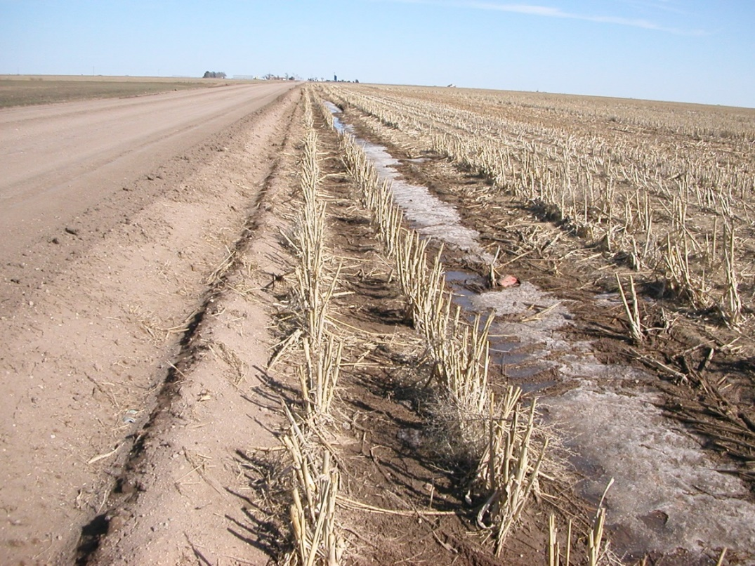
Farming right-of-way
Farming is always harmful.
Never mow around farm crops it just tells that farmer and everyone that drives the road it is OK.
As a township official you should be setting an example and not farm the right-of-way.

Slide 38
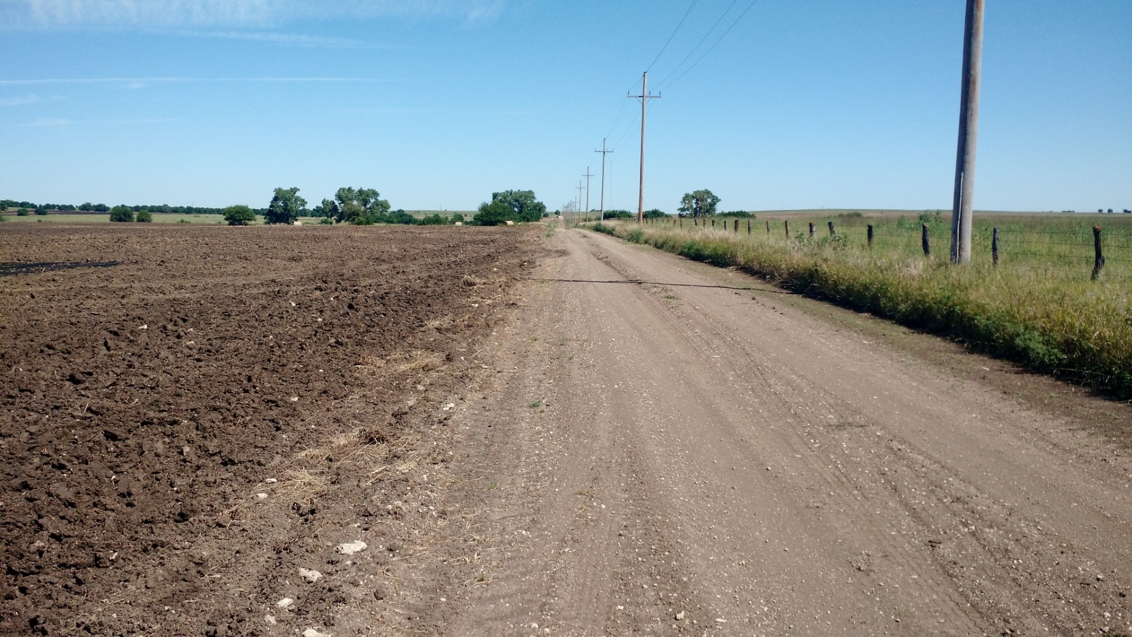
Farming right-of-way

Slide 39
Farming R/W is Unlawful
68-545. Unlawful obstructions, excavations, removal of materials, dumping trash or other materials or plowing of roads; penalty; payment of cost to restore. It shall be unlawful for any person or persons to obstruct any portion of a public highway, including any portion of the entire right-of-way, in any manner with intent to prevent the free use thereof, or to make any holes therein, or to remove any earth, gravel or rock therefrom or any part thereof, or in any manner to obstruct any ditch on the side of any such highway and thereby damage the same, to dump trash, debris, sewage, or any other material, on any highway or any ditch on the side of any highway, (continued next slide)

Slide 40
Farming R/W is Unlawful
68-545 continued from previous slide,
or to plow any public highway for the purpose of scouring plows, or for any other purpose except for the improvement of such highway and as directed in writing by the county engineer and the township board of highway commissioners acting jointly. Any person or persons violating the provisions of this section shall be guilty of a misdemeanor, and upon conviction before any court having competent jurisdiction shall be fined for each and every offense under this act in the sum of not more than $200, and shall pay costs of the action and the cost of cleaning the public highway and restoring it to its prior condition.

Slide 41
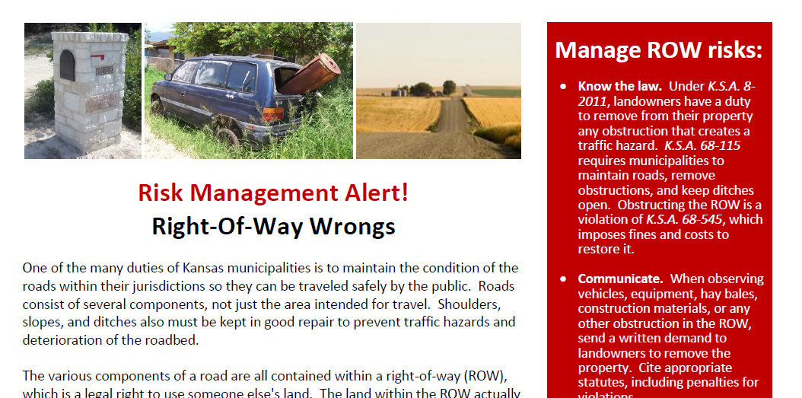
Obstruction flier from KCAMP

Slide 42
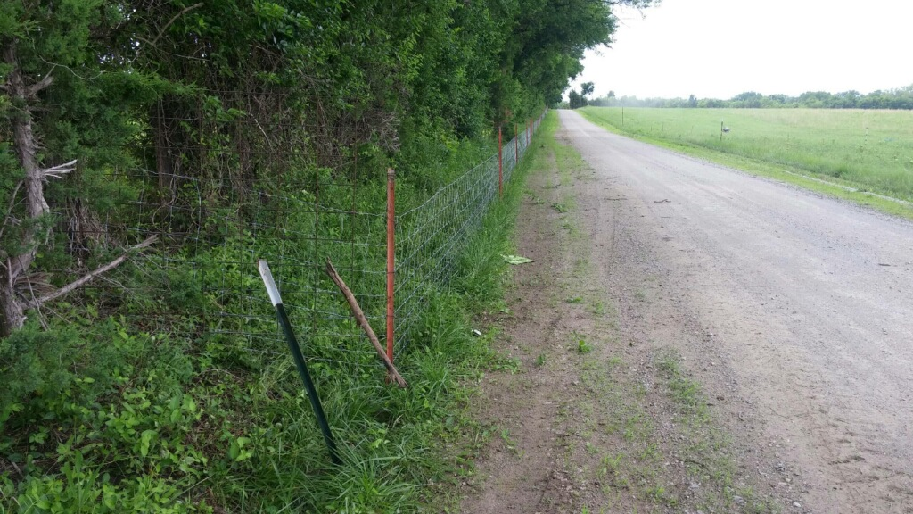
Obstructions

Slide 43
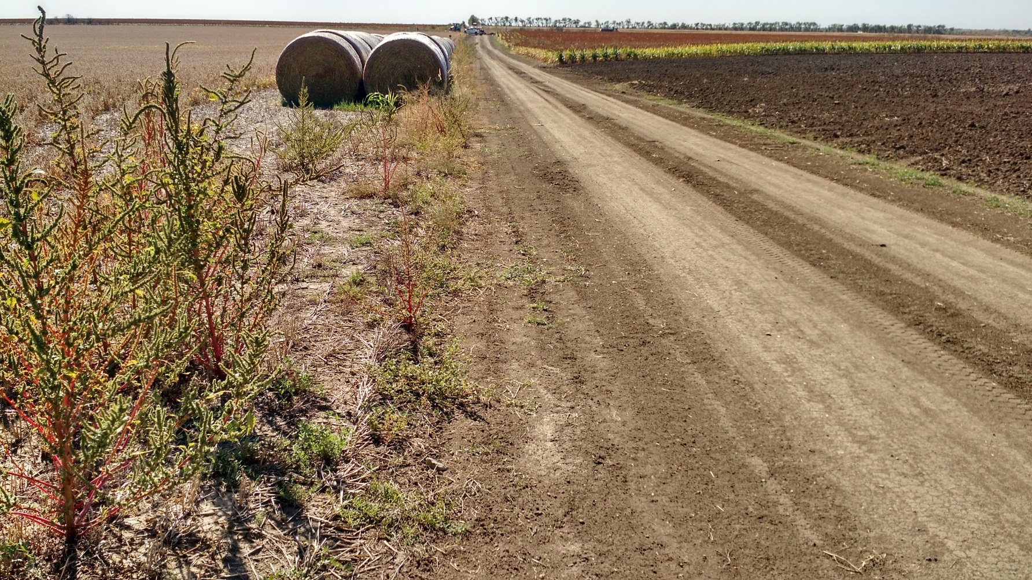
Obstruction

Slide 44
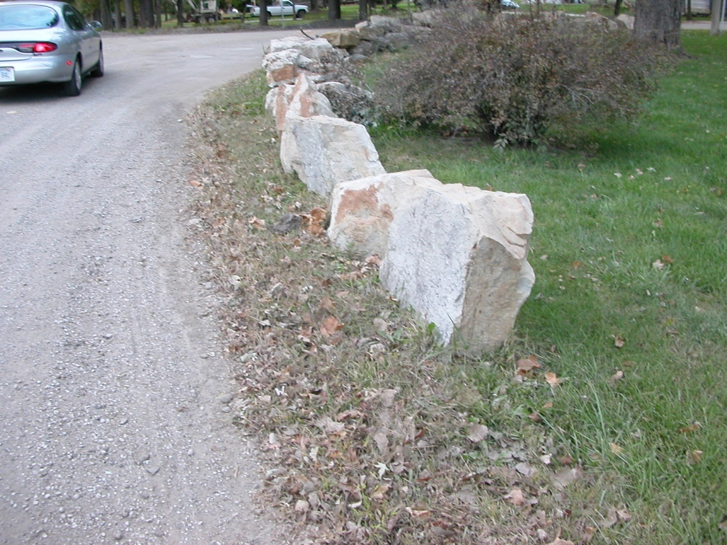
Traffic Hazards on the right-of-way
Landowner installed rocks along edge of road to prevent vehicles from encroaching on yard. Is this legal?
No- Installed without permission, obstructs the right-of-way and is a traffic hazard. Tell him to remove it before you do and charge him for it.

Slide 45
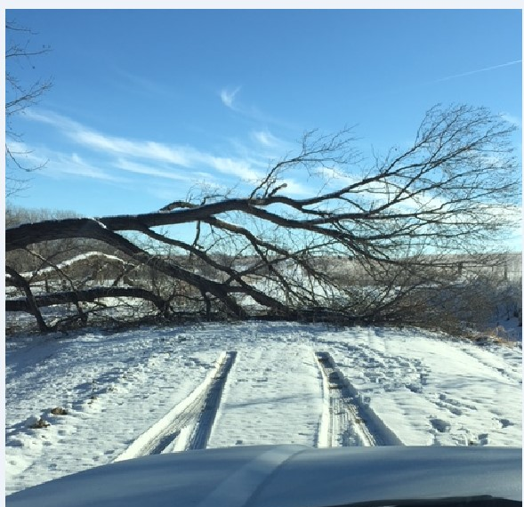
Whose Tree?

Slide 46
Whose Tree?
Tree behind the right-of-way line falls onto the road.
Question: Who does the tree belong to the owner or township?
Answer: Tree still belongs to the landowner. But road agency has duty to clear the road

Slide 47
Trees
Tree that is on private property and falls onto the road still belongs to the owner.
County has duty to clear the road.
So can you throw the limbs over the fence?
Probably not good public relations.
Could notify the owner to take care of his tree, then bill him for work if he doesn’t.
Usually we just take care of it.

Slide 48
Tree Ownership
County typically has a road easement, so even trees on the right-of-way belong to the adjacent owner.
County has authority to remove obstructions, tree limbs and most trees could be considered and obstruction.
Generally, we can remove, when needed for road purposes, trees where the trunks are entirely on road right-of-way.

Slide 49
Street Trees
Street Trees- Trees with landscape or wood value.
People love their trees, and as you would expect there have been a lot of court cases involving trees on the right-of-way and the governments’ decisions to remove street trees.
Basically, we need a good road-related reason to remove street trees, and if the decision is arbitrary we can be sued for damages.

Slide 50
Trimming Trees
Trees, brush, and overhanging limbs are obstructions to maintenance and travel on the road and are sometimes a traffic hazard or sight distance restriction.
We can always trim up to the right-of-way line.

Slide 51
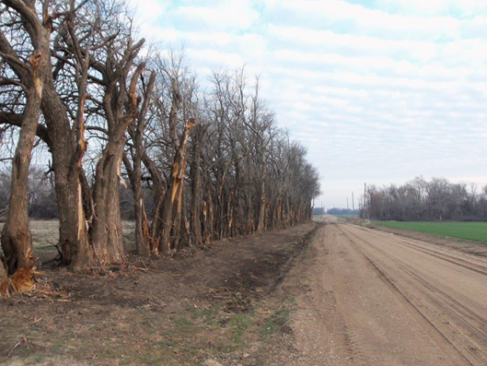
Trimming Trees
We can trim up to the right-of-way line, even if it looks ugly.

Slide 52
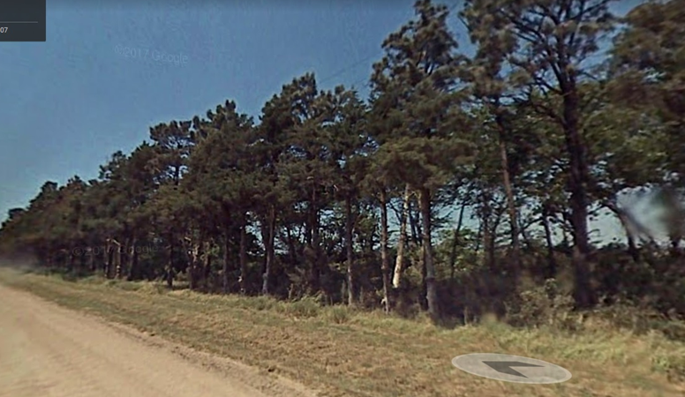
Trimming Trees
We can not trespass and trim past the right-of-way line. This row of trees was planted off the right-of-way, and township had to pay damages for the trimming.

Slide 53
Trees on right-of-way line
We cannot remove or kill trees that are on the right-of-way line without permission from the land owner. Except within 350 feet of a corner.

Slide 54
Trees on right-of-way line
K.S.A. 19-2612. The board of county commissioners of each county in the state are authorized to cut all hedge fences, trees and shrubs growing upon the highway right of way or on right of way boundary, within three hundred fifty (350) feet of a railroad grade crossing or abrupt corner in the highway, and thereafter keep the same trimmed to provide clear vision,

Slide 55
Private Lines
A local land owner needs to run a water line on the right-of-way from his house to a water well about a half mile away.
Question: Can the township or county grant permission to install the water line?
No, we only have an easement for road purposes.
Notes:
55
55

Slide 56
Private Lines
Private owners sometimes want permission to install a pipeline on right-of-way.
Water line from a water well to a house
Crude oil line between a well and tank batteries
Irrigation line
Waste line from a feedlot to a lagoon
State law does not appear to allow private lines on public r/w.
The AG has opined many times (81-242. 82-27, 82-228 & 99-53), that counties cannot allow private lines.
Almost everyone allows road crossings as by their nature they are authorized by the adjacent land owner.
Notes:
56
56

Slide 57
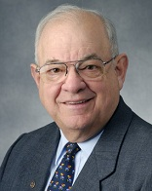
Question: What makes a good road?
  Tom Mulinazzi, PhD, LS & PE
  Professor of Civil Engineering
  Kansas University
  D_____________
  D_____________
  D_____________
  D______________
  Answer: Drainage, Drainage, Drainage & Drainage

Slide 58
Drainage Drainage Drainage
& Drainage
Drainage – Crust that will shed water.
Drainage –proper crown to get water to shoulder.
Drainage-no high shoulder so water can get to ditch.
Drainage-ditch adequate to handle most rains.

Slide 59
Enemies of a Gravel Road?
What are the four enemies of a gravel road?
W________
T_________
G_________ __________
F__________

Slide 60
Enemies of a Gravel Road?
Weather
Traffic
Grader Operator
Farmer
Grader Operator: If you are not doing the right thing at the right time you shouldn’t be there.”

Slide 61
Cross Slope (crown)
I have a 24 ft. wide gravel road.
Question: What is the minimum and maximum crown for this road.
Answer: 6” minimum & 9” maximum

Slide 62
Cross Slope (crown)
Experts agree proper crown on unpaved road is 4 to 6%. (1/2” to ¾” per foot)
A four percent crown is minimum.
  Four percent is ½” per foot
  5” in 20 ft. road & 6” in a 24 ft. road
In two pass blading system too little crown is much more predominant than too much crown.

Slide 63
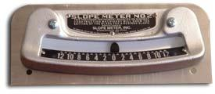
Every grader should have a Slopemeter - $200.
Proper slope is 4 to 6 percent. (1/2 to ¾” per foot)
Slope meters do not work with worn blades.

Slide 64
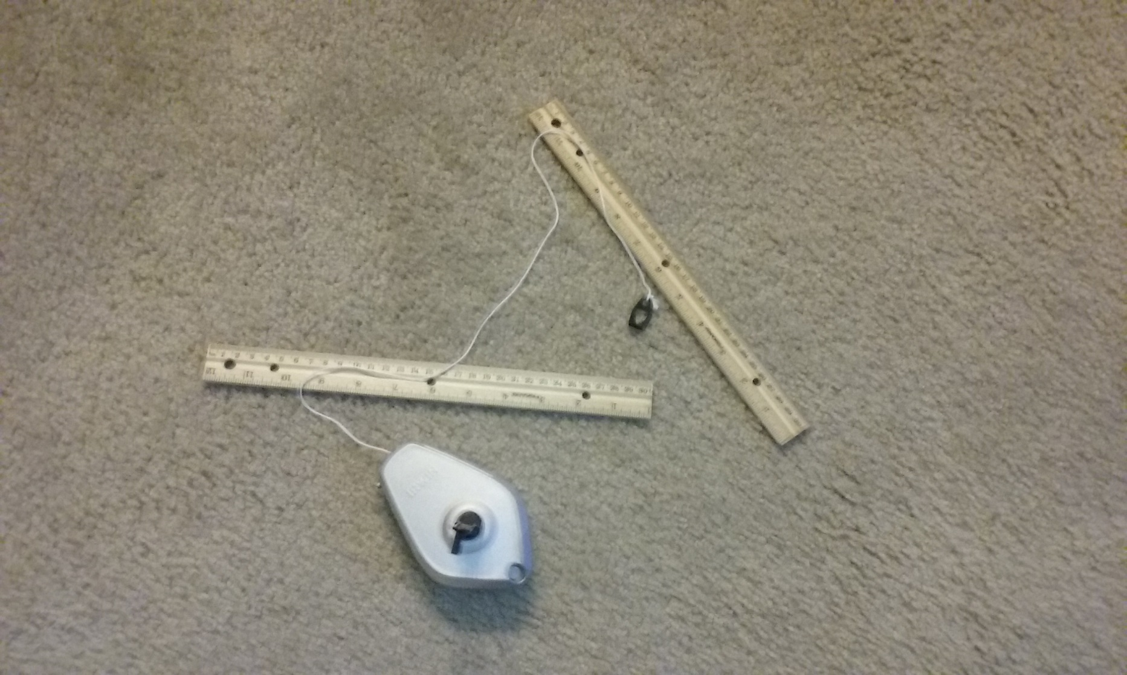
Can use a string line and rulers to check crown. There should be a minimum of 5” crown in center 20 feet.

Slide 65
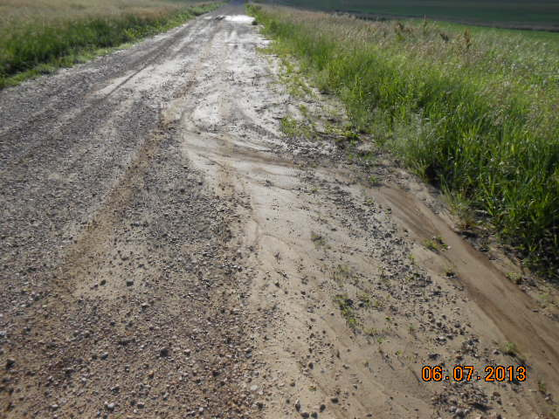
Not enough crown and false shoulders.

Slide 66
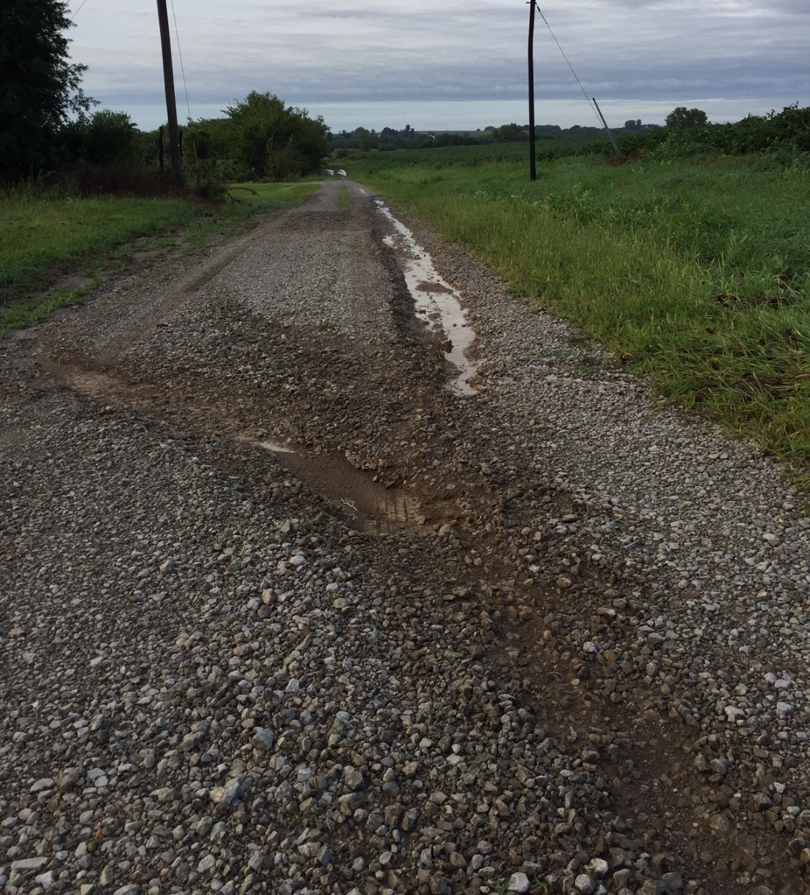
Common Problem
Water runs down driveway
Water runs onto road from driveway sloping toward road.
Lack of crown so water runs down track and across road.

Slide 67
Potholes
Question: What is the cause of potholes on low traffic roads ?
Answer: Grader operator

Slide 68
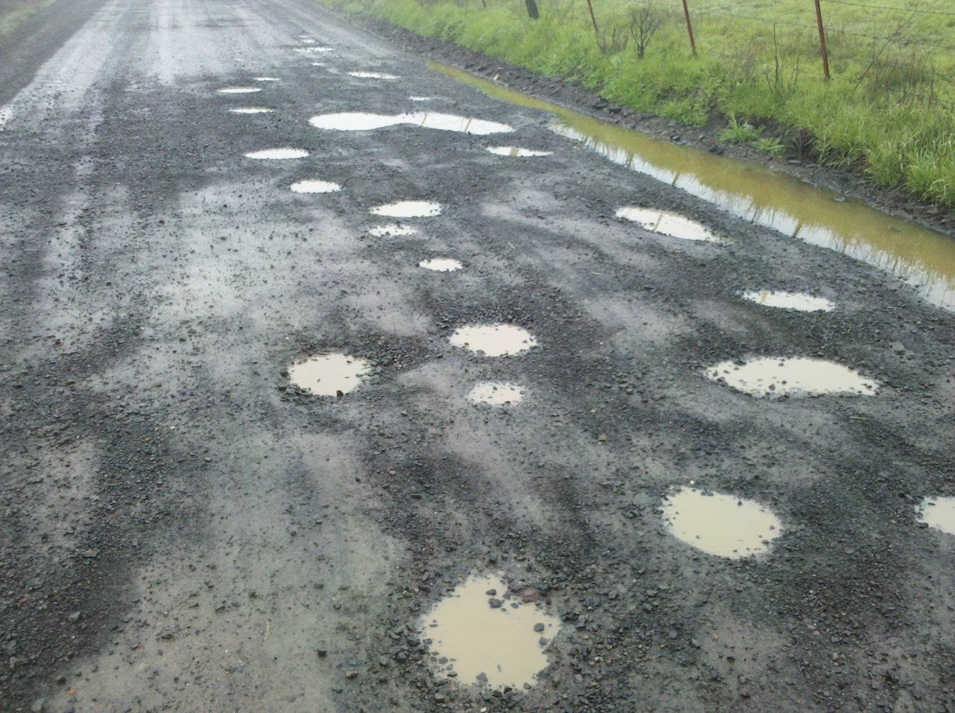
Potholes-always have insufficient crown

Slide 69
Potholes
Potholes are usually caused by poor surface drainage (lack of crown) and occur where water stands in the wheel tracks.
Potholes are more likely to develop on high-traffic roads and during prolonged wet spells and rains. Typical locations are flat areas on top of hills and over cross-road culverts.
Prevent potholes by maintaining adequate crown on the roadway, and consider more crown in problem areas.

Slide 70
Wet Weather: Potholes
If surfacing material is marginal we get rutting (mud hole) in these areas rather than potholes.

Slide 71
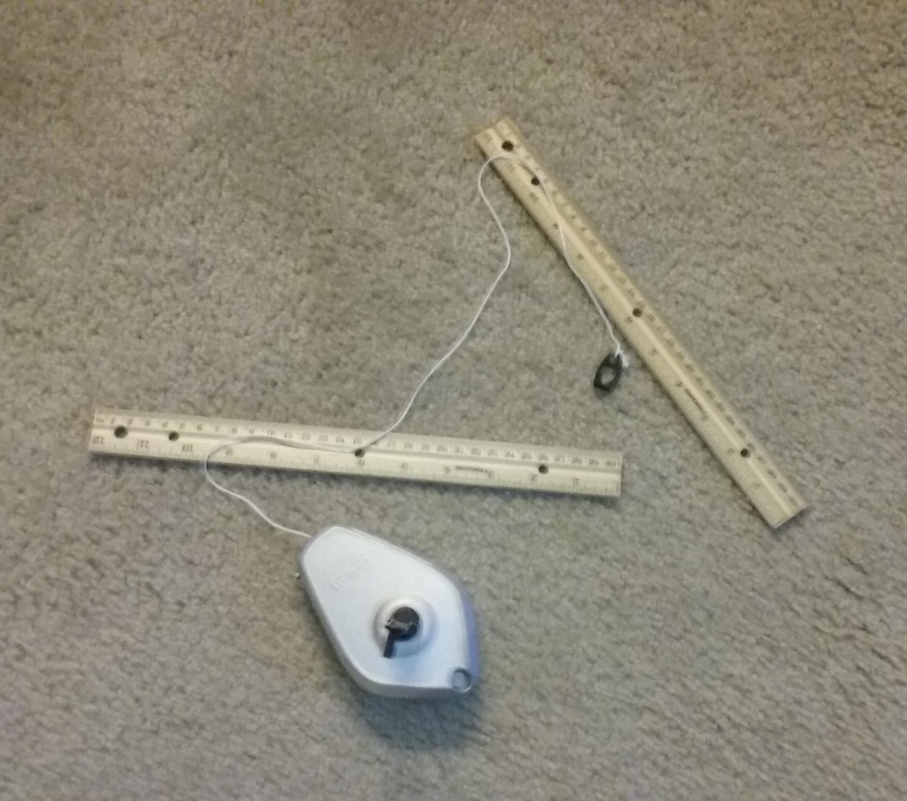
Potholes-Check Crown!
Check crown in potholed areas and up the hill with a string line.
Should have 5” min. crown in center 20 feet.
To emphasize crown every year we should get with grader operator and check crown with him at random locations and trouble spots.

Slide 72
Rutting
Question: What are the two causes of rutting on a gravel road?
Answer:
Not enough surfacing material for traffic
Lack of crown
Not enough crown, road gets beat down in track during wet spell and water stands in the road.

Slide 73
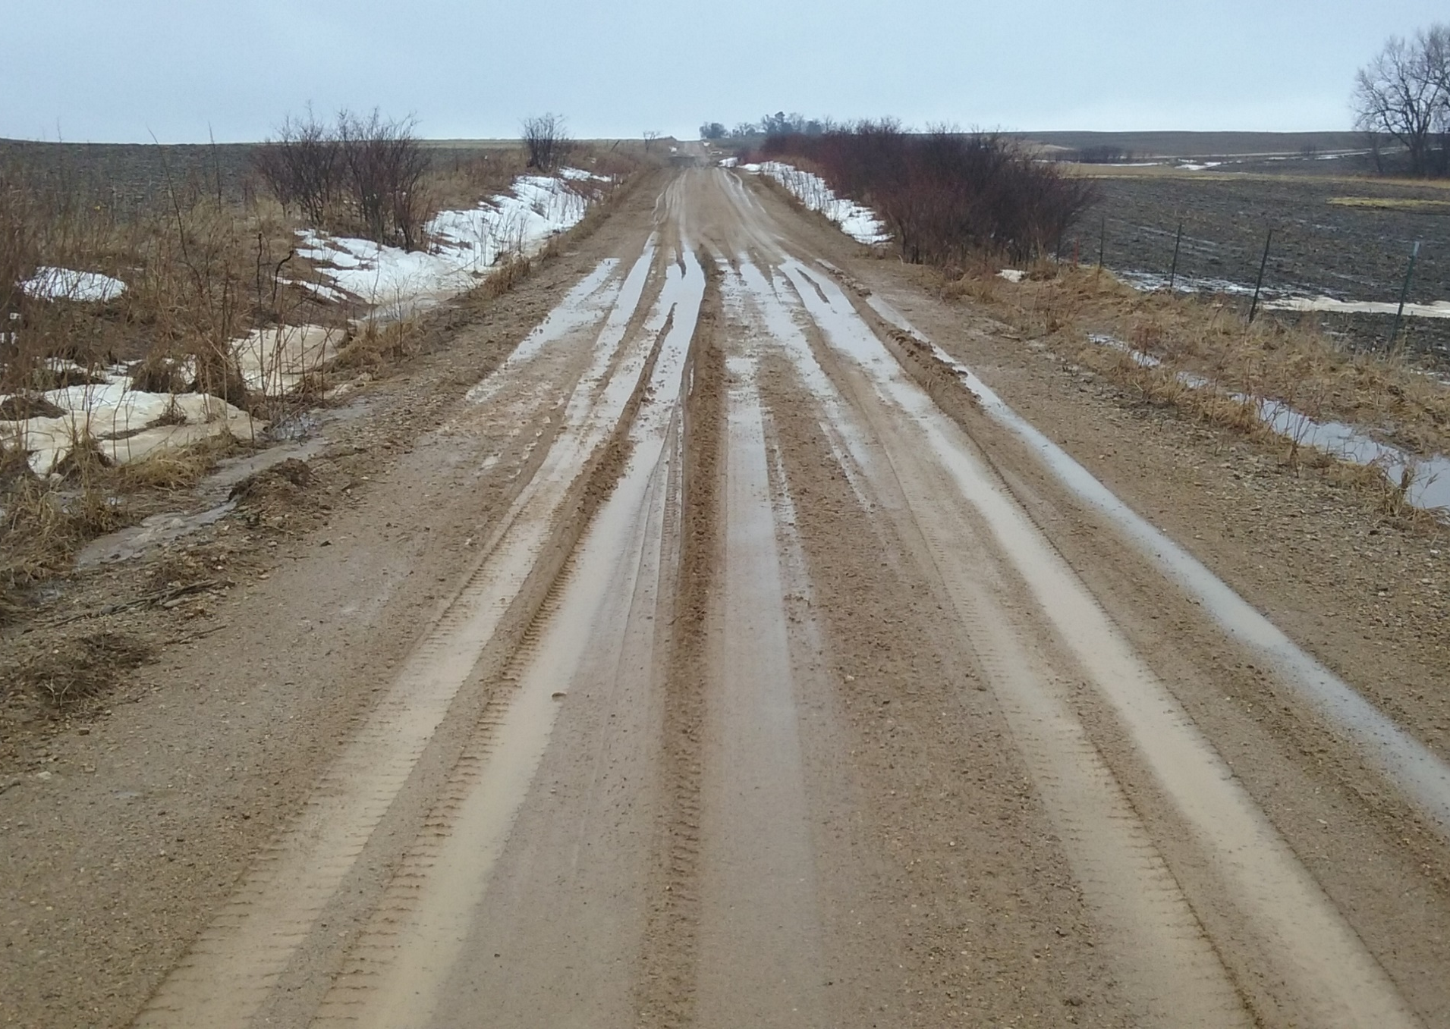
Wet Weather: Mudholes
Minimal crown to start, traffic pounds down crown, Water runs down track and stands in the low area.
Windrow & false shoulder also holding water on road.

Slide 74
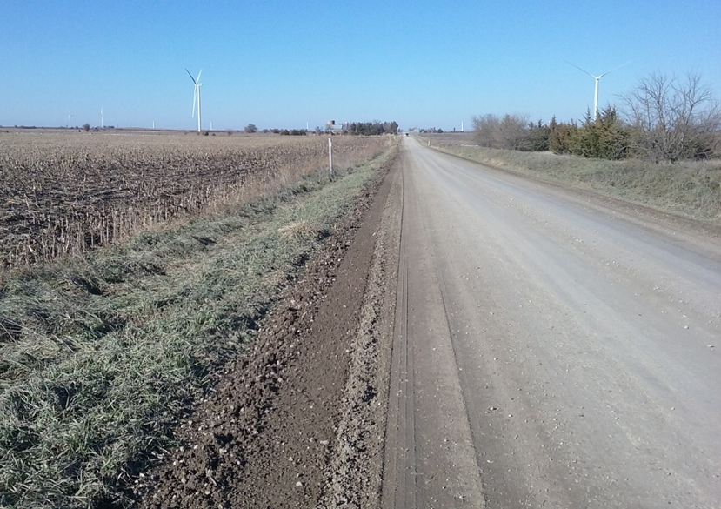
Mudhole coming !
Road with high shoulders, marginal surfacing and little crown. Not a bad road in good weather, will be a mudhole in prolonged wet weather.

Slide 75
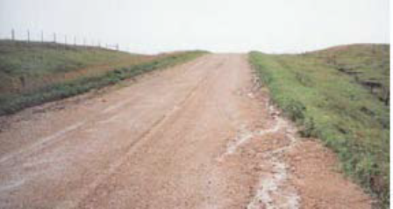
Question: What is the cause of false shoulders?
Answer: Worn blades and not blading to the edge of the foreslope

Slide 76
Crown & Rotating cutting edges
Proper crown cannot be attained with worn cutting edges.
Every agency should have a policy on rotating cutting edges when worn say ¾”
You can rotate the blade from under the grader or use a blade changing tool like Leachrod.
Saves money too as all the cutting edge wears.
Consider carbide cutting edges.

Slide 77
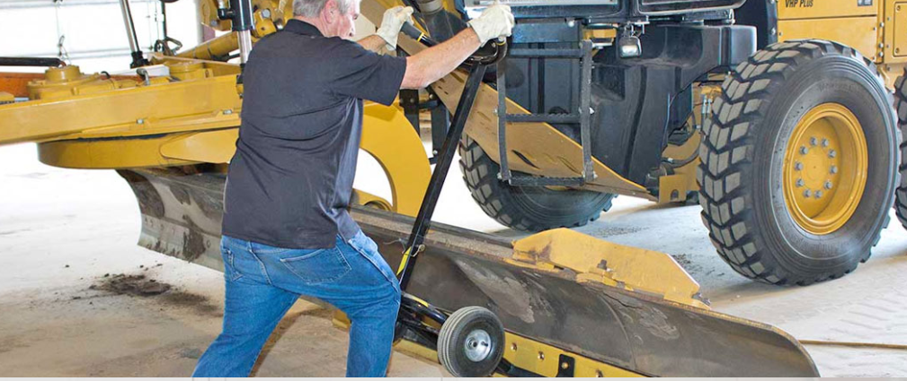
Leachrod

Slide 78
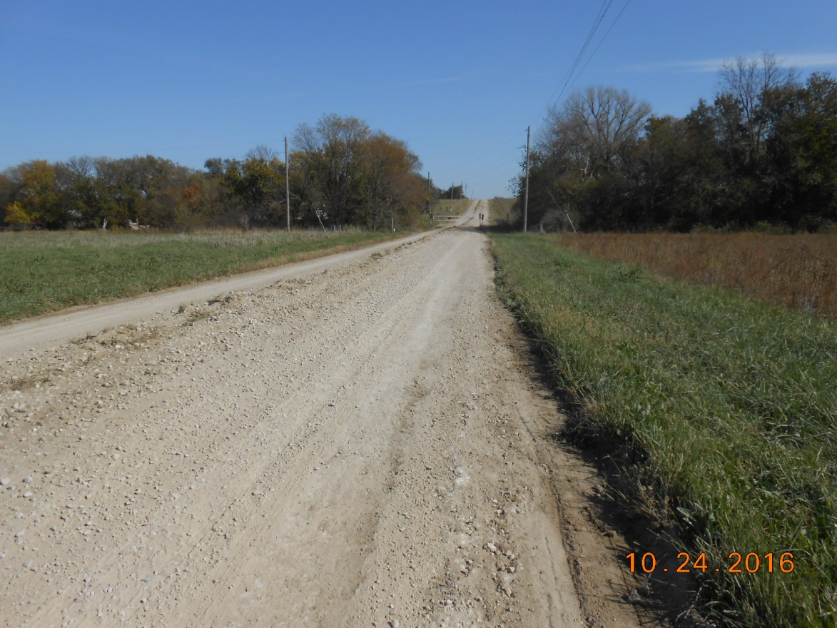
High shoulder caused by worn blades

Slide 79
Proper Crown Summary
Establish crown tolerance for your agency
Slopemeters in graders
Check crown on road with each operator once a year.
Check crown in washboard and rutting areas.
Rotate cutting edges or use carbide embedded blades.

Slide 80
Question : What is the speed limit on a gravel road?
Answer: 55 MPH unless otherwise posted.
8-1558. Maximum speed limits.
(3) on any county or township highway, 55 miles per hour
8-1557. Basic rule governing speed of vehicles. No person shall drive a vehicle at a speed greater than is reasonable and prudent under the conditions and having regard to the actual hazards then existing. Consistent with the foregoing, every person shall drive at a safe and appropriate speed when approaching and crossing an intersection or railroad grade crossing, when approaching and going around a curve, when approaching a hill crest, when traveling upon any narrow or winding roadway, and when special hazards exist with respect to pedestrians or other traffic or by reason of weather or highway conditions.

Slide 81
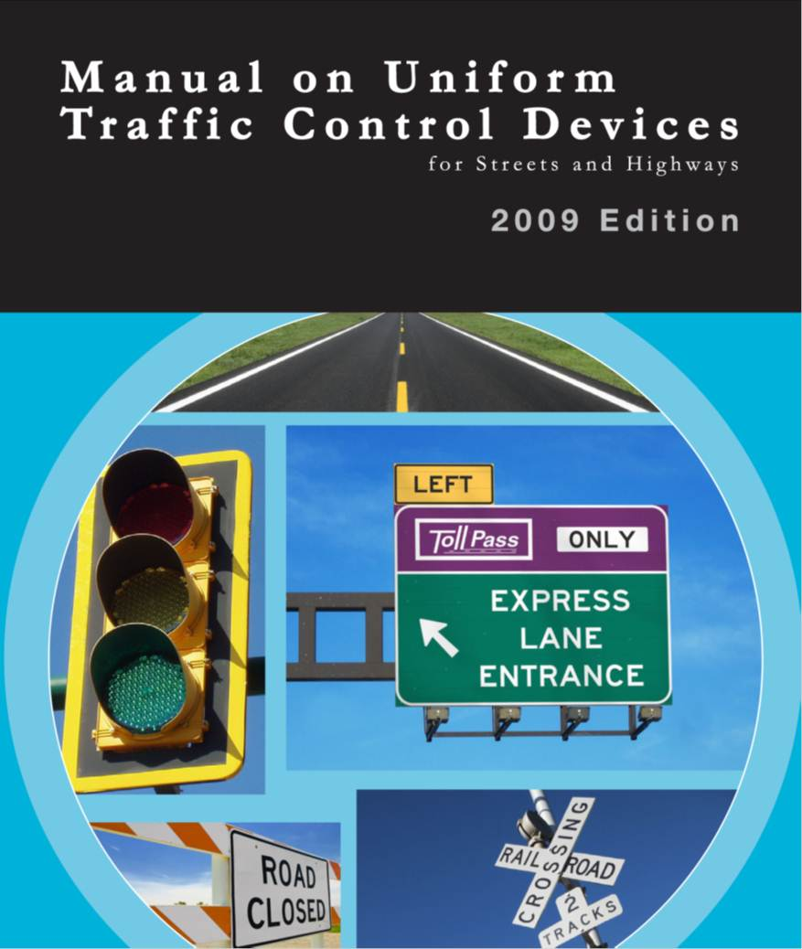
Question: What is the legal standard for signs on township roads?
Answer:
2009 MUTCD was
adopted by the Kansas Secretary of Transportation in December 2011.
Applies to all public roads.
Yes, that means township roads!
Notes:
81

Slide 82
Question: Who enforces signing standards in the MUTCD?
Answer: Ambulance Chasers
Enforcement of signing standards is based on tort liability. If signs are not right and someone gets hurt the possibility of losing in court is very high.

Slide 83
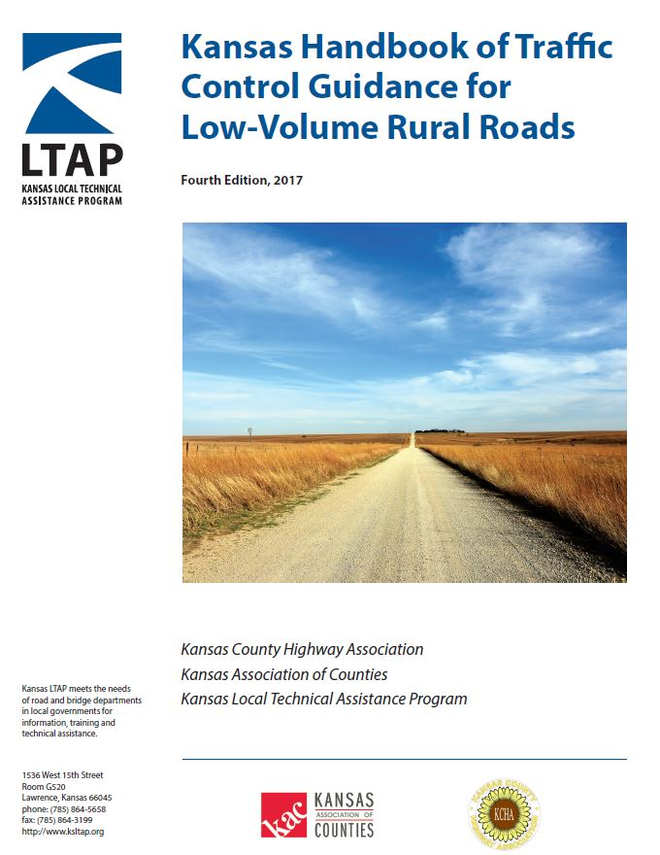
Question: Is there a signing guide for low volume roads?
YES
Applies only to rural roads with less than 400 vehicles per day. Should be fully compatible with the MUTCD. Can obtain a copy from Kansas LTAP
Notes:
83
83

Slide 84
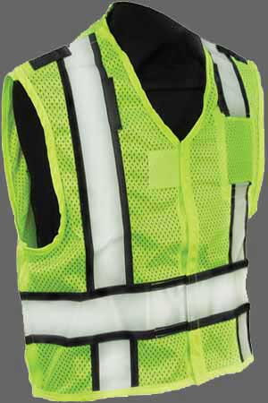
Question: What safety apparel is grader operator required to wear when outside the cab?
MUTCD requires all workers within the public right of way to wear safety apparel.
Applies to all roads
Daytime: ANSI Class 2
Nighttime: ANSI Class 3 (sleeves)

Slide 85

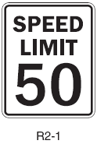
Question: What type of signs on township roads must be authorized by county commission?
    Regulatory Signs
        Colored white, red, or black
        Advise of a legal requirement
        Requires a Resolution

Slide 86
Regulatory Signs on TWP Roads
Regulatory Signs: STOP, YIELD, Speed Limits, No Parking
Regulatory Signs have to be authorized by county commission resolution.
So if you believe a regulatory sign is needed contact the public works department.
If the township installed a regulatory sign without county approval-contact public works department.
Sometimes an engineering study is required.

Slide 87
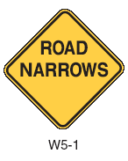
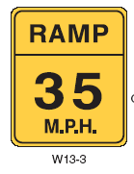
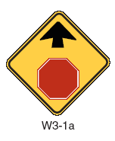
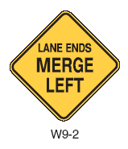
Question: What signs can township install without consulting county?
    Warning Signs
      Colored yellow or orange
      Provide advanced warning information
      Not enforcement related
    Township installs and maintains warning signs at their discretion.
Notes:
Warning signs call attention to unexpected conditions on or adjacent to a highway or street, and to situations that might not be readily apparent to road users. Warning signs alert road users to conditions that could require a reduction of speed or an action in the interest of safety and efficient traffic operations. Traffic citations cannot be issued because of non-compliance with a warning sign. Advisory speed limit signs, like those found on freeway ramps, sometimes cause confusion in this way.

Slide 88
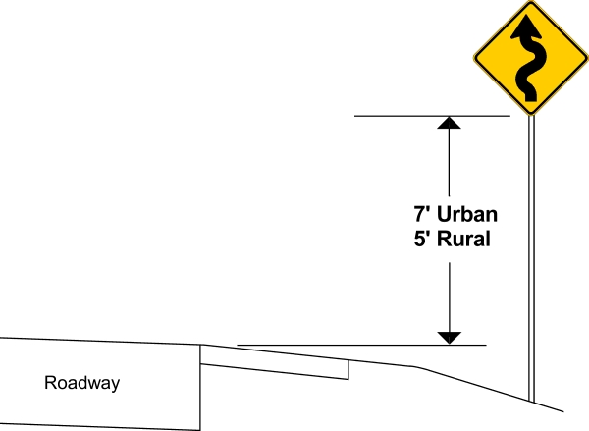
Question: How high should a sign be mounted above edge of road.
5 Ft. to bottom of sign.
4 ft. if it has an advisory speed plaque.
Notes:
The MUTCD specifies the minimum height of signs so that road users can see them. In urban areas or other locations where other vehicles may block a driver’s view, install signs 7 ft (2.1 m) above the edge of the roadway. In rural areas, 5 ft (1.5 m) is the minimum. Install directional, regulatory, and warning signs on freeways and expressways at least 7 ft (2.1 m) above the pavement edge. If a secondary sign is mounted below a major sign, install the major sign at least 8 ft (2.4 m) and the secondary sign at least 5 ft (1.5 m) above the pavement edge.
The MUTCD does not specify the maximum height of signs, but sometimes it is useful to place the sign higher than normal, for example, so it can be seen over a crest in the road.

Slide 89
Mounting Height with advisory speed plaque

Slide 90
Question: How far should sign be set from edge of road?
Ground-mounted signs 12 ft from edge of traveled way
In restricted areas sign may be set a minimum 2 ft from face of curb or edge of road-not the post, the edge of the sign.
Notes:
Where conditions permit, place signs on roads without curbs so that there is a lateral or side clearance of at least 12 ft (3.6 m) from the edge of the travel lane to the near edge of the sign, or 6 ft (1.8 m) from the edge of the shoulder, where the shoulder is more than 6 ft (1.8 m) wide. When there is something in the way, or the sign will not be visible, the best course is to locate the sign as far from the edge of shoulder as possible.
In areas where space is limited, use a minimum lateral offset of 2 ft (0.6 m). On curbed roads where sidewalk width is limited or where poles are close to the curb, locate the edge of the sign 1 ft (0.3 m) or more from the face of the curb. Place the sign farther from the curb, if possible, to reduce the chance of a vehicle hitting it. This is especially true on corners where trucks turn frequently. Always ensure that the sign and signpost will not block the sidewalk.

Slide 91
Question: How big of a wood post can be used for a sign?
Maximum size of wood post is 4” x 4”
MUTCD requires that ground mounted signs must be crashworthy and will bend or breakaway:
4 x 4 wood post
3 lb. max U channel
2.25” square steel-perforated

Slide 92
Question: Turn Sign should be used where the advisory speed is ______ MPH or less?
Turn sign to be used where advisory speed is 30 MPH or less.

Slide 93
Curve Sign
Curve sign to be used where advisory speed is 35 MPH or greater.

Slide 94
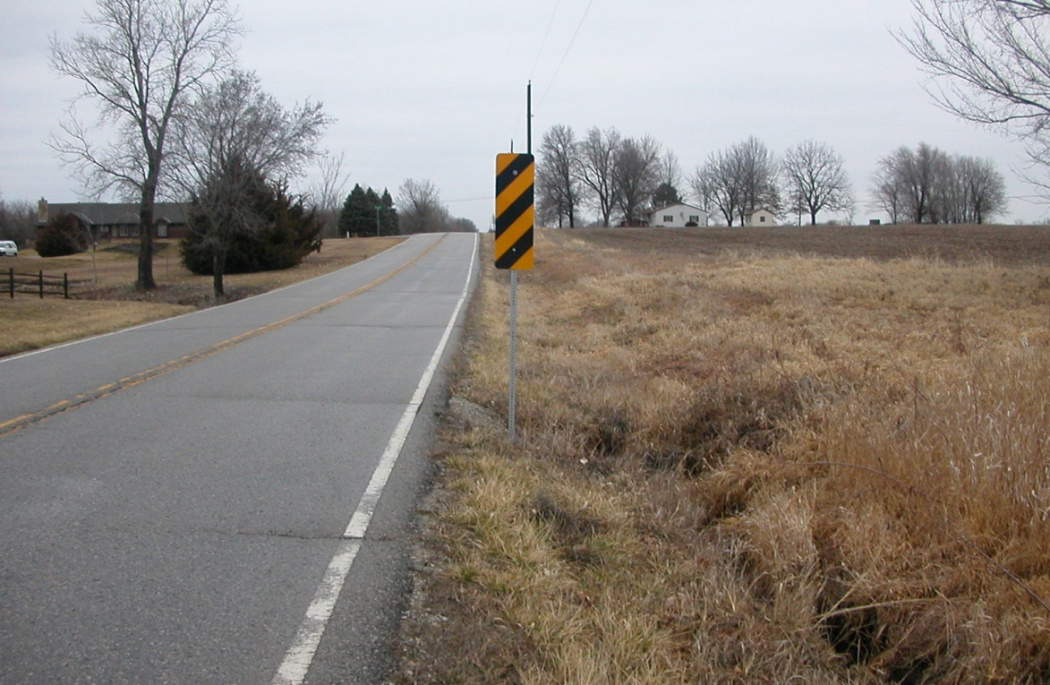
Object Markers
Object markers are set to mark hazards in or near the roadway.

Slide 95
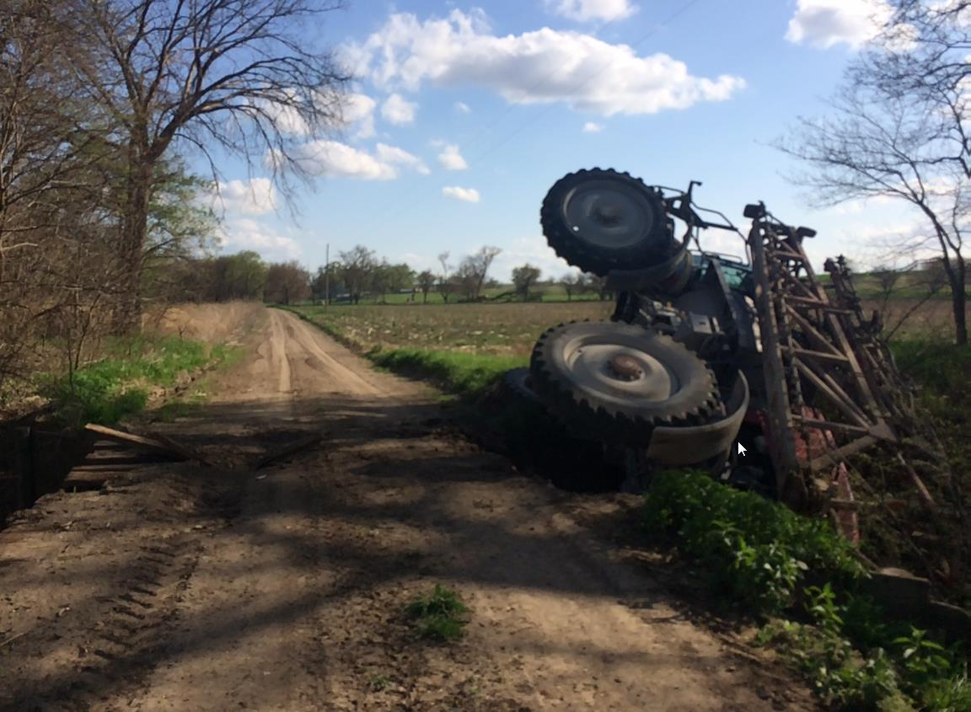
Object Markers Missing
Totaled a sprayer - $130,000 claim against the county.

Slide 96
Wide Farm Equipment
I have a cross road culvert where object marker keeps getting knocked down by wide farm equipment. Can I put up a flexible object marker (carsonite)?
Yes under certain circumstances.
Note: We only modify the standard object marker in a location where the standard object marker would be damaged by wide farm equipment. See LVR Signing Guide for more information.

Slide 97
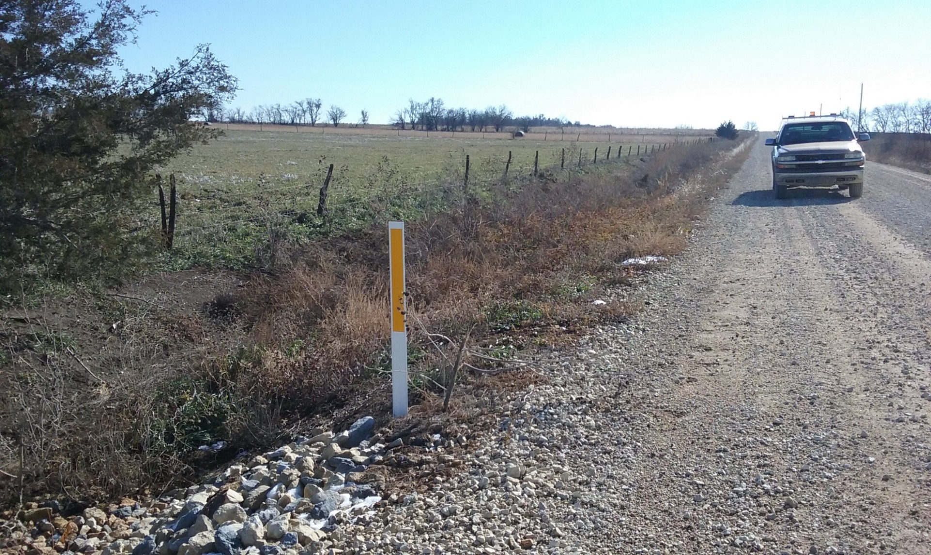
OM-2 where farm equipment is an issue
Need 24” sheeting if within 4 ft. of road edge.

Slide 98
Sign night time visibility
We just have low volume roads and few strangers drive our roads at night so we are not required to check our signs for night time visibility. True or False
False: Requirements that signs be visible at night have been included in every edition of the MUTCD, since the first edition in 1935.

Slide 99
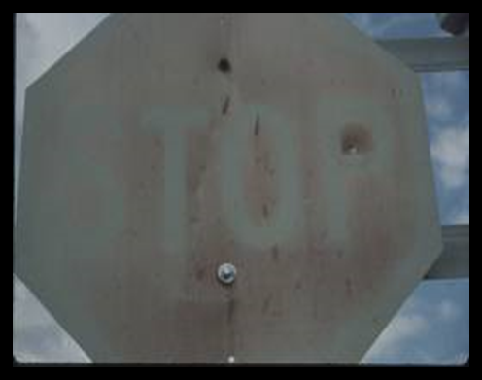
MUTCD Language : Section 2A.09 Maintaining Minimum Retroreflectivity
“Standard:
Public agencies or officials having jurisdiction shall use an assessment or management method that is designed to maintain sign retroreflectivity at or above the minimum levels in Table 2A-3”
Notes:
This is the meat of the new requirement. <READ ALOUD SLOWLY>
It is a shall statement meaning it must be satisified.
You must: use a maintenance method to maintain your signs at minimum retroreflectivity levels.

Slide 100
K.S.A. 8-2005
In all counties operating under the county-township system, responsibilities for traffic-control devices and signage shall be as follows:
(1) Counties shall maintain the county roads and shall place and maintain traffic-control devices on county roads. Counties shall maintain and place on township roads signs related to county culverts and county bridges, and construction signage related to county projects on township roads.
(continued on next slide)

Slide 101
K.S.A. 8-2005 (continued)
(2) Township boards shall maintain the local township roads and shall place and maintain traffic-control signage on such township roads, except as provided in paragraph (1). Regulatory signs on township roads under the township board’s jurisdiction shall be consistent with resolutions of the board of county commissioners of the county in which the township road is located.

Slide 102
County Responsibility on TWP Roads
The county will maintain following signs related to county culverts and bridges:
  advance warning signs (narrow and one lane bridge)
  weight limit signs
  object markers
The county also maintains any stop ahead signs they installed on township road approaches to county roads.
Street name signs?
As a township official you have a duty to notify county if sign is down or damaged.

Slide 103
Traffic Control for Dragging
Strobe light on the grader is not working, but my flashers are working.
Question: Should I go dragging without a strobe light?
Answer: No, both a strobe and flashers are required.

Slide 104
Traffic Control for Dragging
Applies only to rural roads with less than 400 vehicles per day.
Chapter 10 has traffic control guidance.
Notes:
104
104

Slide 105
Traffic Control-Dragging
10.14 Typical Application - Gravel Road Maintenance (Dragging)
This application is typical maintenance (dragging of unpaved roads). A motor grader shall be equipped with a slow moving vehicle emblem, flashing lights, and a beacon. Flags at the ends of the moldboard are optional. Windrows should begin where they can be seen from a distance. Large windrows should not extend across intersections. Consider optional ROAD WORK AHEAD signs on Road Type A with poor visibility of the grader.

Slide 106
Traffic Control
For any work on the road besides dragging and mowing you will need signs.
Refer to Chapter 10 of the low volume road guide for examples.

Slide 107
Question: Where can townships get training
Kansas LTAP
Local Technical Assistance Program (LTAP) at KU
Provides one day classes for $75
LTAP has lending library, free publications, and a quarterly newsletter on road issues.
www.kutc.ku.edu
If your township is not getting the newsletter-it is free- just contact LTAP.

Slide 108
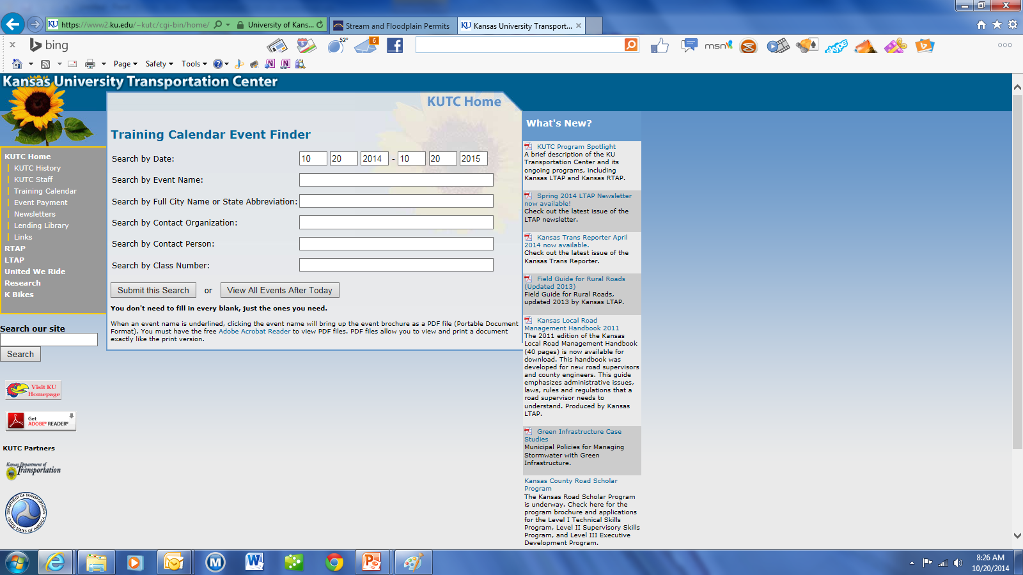
Kansas LTAP Website
Google: Kansas LTAP

Slide 109
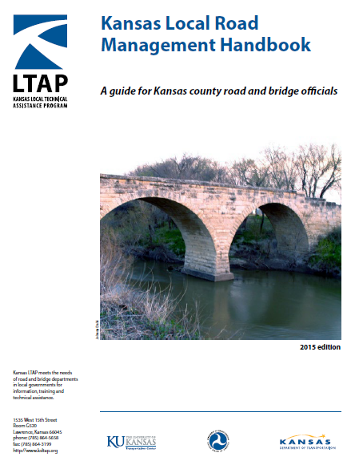
Documents you should have.

Slide 110
Things to remember
You have a duty to maintain the roads reasonably safe for public travel.
Understand agreements on border roads.
Take signing seriously
If you make a decision contrary to public safety it is probably the wrong decision.
Make it safer

Slide 111
Finished – Thank You
Staying Informed
Technical Training:
Local Technical Assistance Program (LTAP) at KU
Provides one day classes for $75
LTAP has lending library, free publications, and a quarterly newsletter on road issues.
www.kutc.ku.edu
If your township is not getting the newsletter-it is free- just contact LTAP.

